Slide 1
Random-Number and Random-Variate Generation
By
Dr. M. Mohamed Surputheen

Slide 2
Overview
Properties of Random Numbers
Generation of Pseudo Random Numbers
Techniques for Generating Random Numbers
Tests for random numbers
Random-Variate Generation

Slide 3
Random Number Generation
A random number is a number that cannot be predicted by an observer before it is generated.
Pseudo-random number is a sequence of numbers that appears to be random that is generated using an initial value.
Random numbers are an important part of the modern world of computing. Cryptography, simulation, and system testing all rely on random number generation

Slide 4
Random numbers are necessary basic ingredient in the simulation of almost all discrete system.
Most computer languages have a subroutine or function that will generate a random number.
Random numbers play a key role in discrete event simulation.
Simulation languages generate random numbers that are used to produce random arrival/service times and event times and other random variables in general.
A random number generator (RNG) is a computational or physical device designed to generate a sequence of numbers that appear random.

Slide 5
Historical methods of generating random numbers include:
Dice throwing.
Coin Flipping.
Shuffling of playing cards.
Alternatively results can be collected and passed out as random number tables.
In modern days, With the advent of computers there are several techniques to Quickly generate ‘random numbers’.
A random number is a number uniformly distributed between 0 and 1.

Slide 6
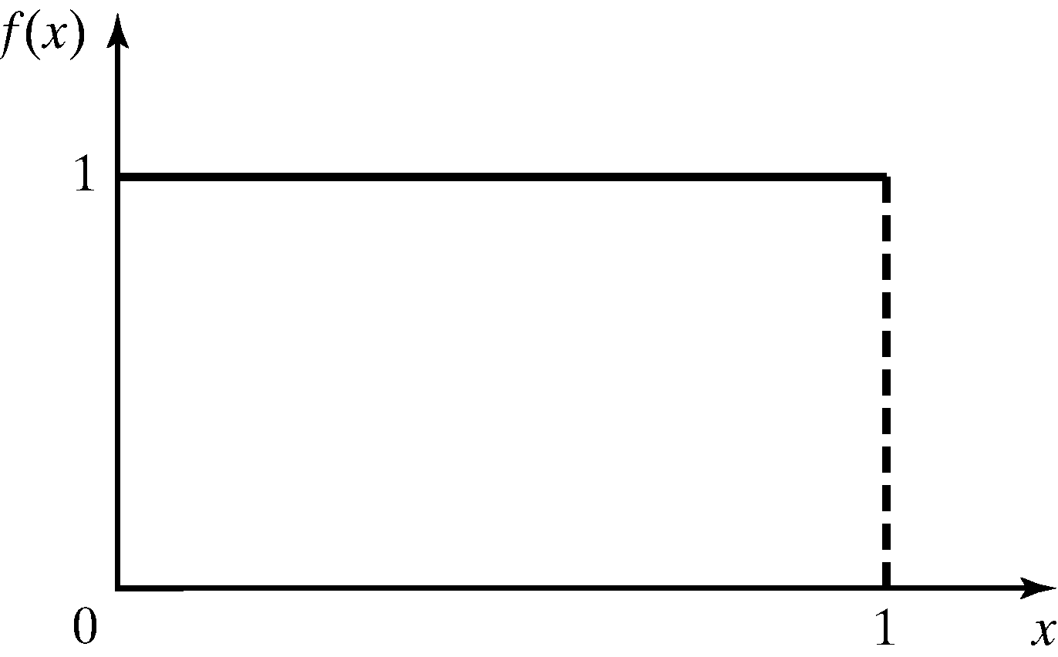
1.Properties of Random Numbers
A sequence of random numbers R₁, R₂, …, must have two important statistical properties:
  Uniformity
  Independence.
Random Number, R_{i}, must be independently drawn from a uniform distribution with pdf:
pdf for random numbers
6
Notes:
6

Slide 7
Properties of Random Numbers (cont.)
Uniformity: If the interval [0,1] is divided into n classes, or subintervals of equal length, the expected number of observations in each interval is N/n, where N is the total number of observations
In a uniform distribution, any number within the specified range
[ for eg. 0 to 1] has equal probability of occurring
Independence: The probability of observing a value in a particular interval is independent of the previous value drawn
(ie) the current value of a random variable has no relation with the previous values.
7

Slide 8
2.Generation of Pseudo-Random Numbers
The word “Pseudo” is used, because generating numbers using a known method removes the potential for true randomness. Since the sequence of numbers is deterministic they are referred to as "pseudo-random".
Goal: To produce a sequence of numbers between [0, 1] that simulates, or replicates, the ideal properties of random numbers (RN).

Slide 9
Generation of Pseudo-Random Numbers(cntd)
Problems that occur in generation of pseudo-random numbers (PRN)
  Generated numbers might not be uniformly distributed
  Generated numbers might be discrete-valued instead of continuous-valued
  Mean of the generated numbers might be too low or too high
  Variance of the generated numbers might be too low or too high
  There may be dependence
  Examples:
  a) Autocorrelation between numbers.
b) Numbers successively higher or lower than adjacent numbers.
c)Several numbers above the mean followed by several numbers below the mean
9

Slide 10
Generation of Pseudo-Random Numbers(cont.)
Important considerations in RN routines:
  The routine should be fast. Individual computations are inexpensive, but a simulation may require many millions of random numbers
  Portable to different computers – ideally to different programming languages. This ensures the program produces same results
  Have sufficiently long cycle. The cycle length, or period represents the length of random number sequence before previous numbers begin to repeat in an earlier order.
  Replicable. Given the starting point, it should be possible to generate the same set of random numbers, completely independent of the system that is being simulated
  Closely approximate the ideal statistical properties of uniformity and independence.
10

Slide 11
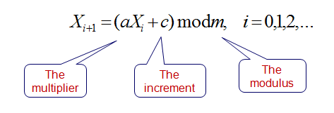
3. Techniques for Generating Random Numbers
Linear Congruential method
To produce a sequence of integers, X₁, X₂, … between 0 and m-1 by following a recursive relationship:
The initial value X₀ is called the seed
The selection of the values for a, c, m, and X₀ drastically affects the statistical properties and the cycle length.
If c≠ 0 then it is called mixed congruential method
When c=0 it is called multiplicative congruential method
11
Notes:
11

Slide 12
Linear Congruential Method
The random integers are being generated in the range [0,m-1], and to convert the integers to random numbers:
12
Notes:
12

Slide 13
Linear Congruential Method (cont.)
EXAMPLE: Use X0 = 27, a = 17, c = 43, and m = 100.
The Xi and Ri values are:
  X1 = (17*27+43) mod 100 = 502 mod 100 = 2,
  R1= 2/100 = 0.02
  X2 = (17*2+43) mod 100 = 77 mod 100 =77,
  R2= 77/100 = 0.77
  X3 = (17*77+43) mod 100 = 1352 mod 100 = 52
  R3= 52/100 = 0.52
  …
Notice that the numbers generated assume values only from the set I = {0,1/m,2/m,….., (m-1)/m} because each Xi is an integer in the set {0,1,2,….,m-1}
Thus each Ri is discrete on i, instead of continuous on interval [0,1]
13
Notes:
13

Slide 14
Linear Congruential Method(cont.)
Characteristics of a Good Generator
The primary importance of LCM is uniformity and independence.
The secondary importance is maximum density and maximum period within the sequence.
Maximum Density
  Maximum density means that the values assumed by R_{i}, i = 1,2,…, leave no large gaps on [0,1]
  Solution: a very large integer for modulus m (e.g., m= 2³¹-1, 2⁴⁸)
Maximum Period
To avoid cycling (i.e. recurrence of the same sequence of generated numbers) the generator should have the largest possible period. This can be achieved by proper choice of a, c, m, and Xo.
14
Notes:
14

Slide 15
Linear Congruential Method(cont.)
Maximum Period or Cycle Length:
i) For Mixed Linear Congruential Generators (c≠0)
For m a power of 2, say m=2^{b}, and c≠0, the longest possible period is P=m=2^{b}, which is achieved when c is relatively prime to m (greatest common divisor of c and m is 1) and a=1+4k, where k is an integer
ii) For Multiplicative Linear Congruential Generators (c=0)
For m a power of 2, say m=2^{b}, and c=0, the longest possible period is P=m/4=2^{b-2}, which is achieved if the seed X₀ is odd and if the multiplier a is given by a=3+8k or a=5+8k for some k=0,1,….
For m a prime number and c=0, the longest possible period is P=m-1, which is achieved whenever the multiplier a has the property that the smallest integer k such that a^{k}-1 is divisible by m is k=m-1
15

Slide 16
Linear Congruential Method (cont.)
Example:
Using the multiplicative congruential method, find the period of the generator for a = 13, m = 2⁶, and X₀ = 1, 2, 3, and 4.
The solution is given in next slide.
When the seed is 1 and 3, the sequence has period 16. However, a period of length eight is achieved when the seed is 2 and a period of length four occurs when the seed is 4.
Notes:
30

Slide 17
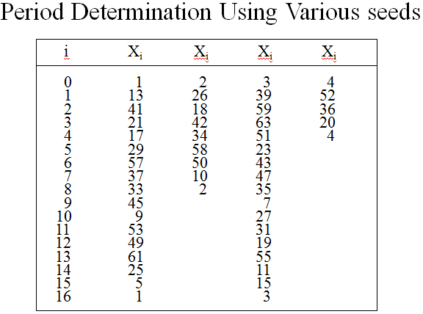
Linear Congruential Method (cont.)

Slide 18
Linear Congruential Method(cont.)
Speed and efficiency in using the generator on a digital computer is also a factor
Speed and efficiency are aided by using a modulus m either a power of 2 (=2^{b})or close to it
After the ordinary arithmetic yields a value of aX_{i}+c, X_{i+1} can be obtained by dropping the leftmost binary digits and then using only the b rightmost digits
18

Slide 19
Linear Congruential Method (cont.)
Example: c=0; a=7⁵=16807; m=2³¹-1=2,147,483,647 (prime number)
Period P=m-1 (well over 2 billion)
Assume X₀=123,457
Xi+1 = aXi mod m
X₁=7⁵(123457)mod(2³¹-1)=2,074,941,799
R₁=X₁/2³¹=0.9662
X₂=7⁵(2,074,941,799) mod(2³¹-1)=559,872,160
R₂=X₂/2³¹=0.2607
X₃=7⁵(559,872,160) mod(2³¹-1)=1,645,535,613
R₃=X₃/2³¹=0.7662
……….
Note that the routine divides by m+1 instead of m. Effect is negligible for such large values of m.
19

Slide 20
4. Tests for Random Numbers
Desirable properties of random numbers: Uniformity and Independence.
Number of tests can be performed to check these properties been achieved or not.
Tests of whether the distribution of the set of random number is uniform are frequently called frequency tests.
Tests of whether the generated numbers are independent of one another are called independence tests
Tests for Uniformity
Frequency Test: Uses the Kolmogorov-Smirnov or the Chi-square test to compare the distribution of the set of numbers generated to a uniform distribution
Tests for Independence
Runs test: Tests the runs up and down or the runs above and below the mean by comparing the actual values to expected values. The statistic for comparison is the chi-square.
Autocorrelation test: Tests the correlation between numbers and compares the sample correlation to the expected correlation of zero.
20
Notes:
20

Slide 21
Tests for Random Numbers (cont.)
Two categories:
  Testing for uniformity. The hypotheses are:
  H₀: R_{i} ~ U[0,1] (ie) numbers are uniformly generated
  H₁: R_{i} U[0,1] (ie) numbers are not uniformly distributed
    Failure to reject the null hypothesis, H₀, means that evidence of non-uniformity has not been detected.
  Testing for independence. The hypotheses are:
  H₀: R_{i} ~ independently distributed
  H₁: R_{i} independently distributed
    Failure to reject the null hypothesis, H₀, means that evidence of dependence has not been detected.
21
Notes:
21

Slide 22
Tests for Random Numbers(cont.)
For each test, a Level of significance α must be stated.
The level α , is the probability of rejecting the null hypothesis H₀ when the null hypothesis is true:
α = P(reject H₀|H₀ is true)
The decision maker sets the value of α for any test Frequently a is set to 0.01 or 0.05
22
Notes:
22

Slide 23
Tests for Random Numbers(cont.)
When to use these tests?
  If a well-known simulation languages or random-number generators is used, it is probably unnecessary to test
  If the generator is not explicitly known or documented, e.g., spreadsheet programs, symbolic/numerical calculators, tests should be applied to many sample numbers.
Types of tests:
  Theoretical tests: evaluate the choices of m, a, and c without actually generating any numbers
  Empirical tests or Statistical test: applied to actual sequences of numbers produced.
  Here we emphasize empirical tests that are applied to actual sequences of numbers produced by a generator.
23
Notes:
23

Slide 24
Test of uniformity
Frequency Tests
Two different methods:
  Kolmogorov-Smirnov test
  Chi-square test
Both these tests measure the degree of agreement between the distribution of a sample of generated random numbers and the theoretical uniform distribution
Both tests are based on null hypothesis of no significant difference between the sample distribution and the theoretical distribution
24
Notes:
24

Slide 25
Frequency Tests
Kolmogorov-Smirnov Test
This test compares the continuous cdf, F(x) of the uniform distribution to the empirical cdf, SN(x), of the sample of N random numbers.
We know:
If the sample from the RN generator is R₁, R₂, …, R_{N}, then the empirical cdf, S_{N}(x) is:
The cdf of an empirical distribution is a step function with jumps at each observed value.
The largest absolute deviation between F(x) and SN(x) is determined and is compared with the critical value, which is available in a table.
        D = max| F(x) - S_{N}(x)|
The distribution of D is known and tabulated (A.8) as function of N
25
Notes:
25

Slide 26
  Steps:
  Rank the data from the smallest to largest
  Compute
  D⁺ = max { i/N – R_{i} }
  D⁻ = max { R_{i} – (i-1)/N }
  Compute D = max (D⁺ , D⁻ )
  Locate the critical value of Dα for the significant level a and the given sample N in table A.8
  If D > Dα , then, the null hypothesis H0 is rejected.
  If D <= Dα , then, there is no difference b/w the true distribution of random numbers generated and the uniform distribution. Hence the null hypothesis is accepted.(i.e, the given random numbers are uniformly distributed.

Slide 27
Kolmogorov-Smirnov Test – Example.
Step 3: D⁺ = max{i/N -R(i)} = 0.26
D⁻ = max{R(i) - (i-1)/N} = 0.21
D = max {D+,D-} = 0.26
Step 4: For a = 0.05, Value from the table = 0.565
D <= D_{a} Hypothesis is not rejected (ie. The given random numbers are uniformly distributed.

Slide 28
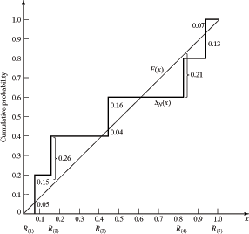

Slide 29
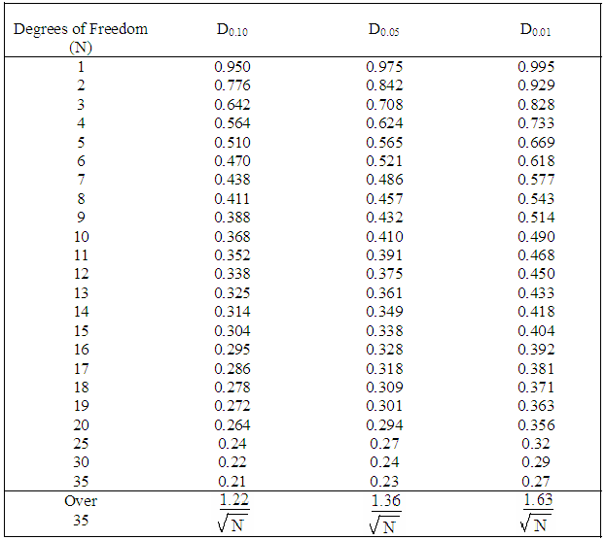
Table A.8 Kolmogorov-Smirnov critical values

Slide 30
The Chi-square Test
The chi-square test uses the sample statistic:
Where:
  O_{i} = the number of observations in the i-th class
  E_{i} = the expected number in the i-th class
  n = the number of classes.

Slide 31
The Chi-square Test
Step 1:
  Divide [0,1) into intervals that represent each discrete value.
Step 2:
  Count how many generated values are in each interval
  Step 3:Calculate:

Slide 32
The Chi-square Test
Step 4:
  For significant level α, utilize the table (Percentage points of the chi square distribution with ν degrees of freedom) to determine χ_{α,n-1}.
Step 5:
  If χ₀² ≤ χ²_{α,n-1} → Accept the hypothesis:
  If χ₀² > χ²_{α,n-1} → Reject the hypothesis:

Slide 33
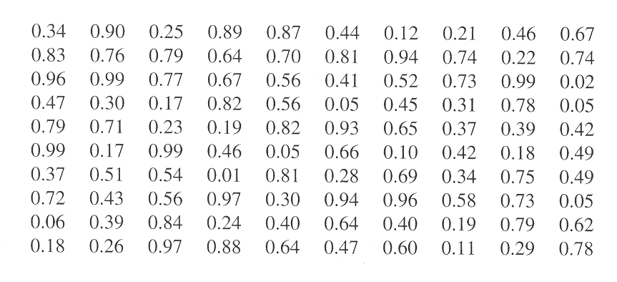
Chi-Square Test (cont.)
Example : Use Chi-square test for the data shown below with α=0.05. The test uses n=10 intervals of equal length, namely [0,0.1),[0.1,0.2), …., [0.9,1.0)
33
Notes:
33

Slide 34
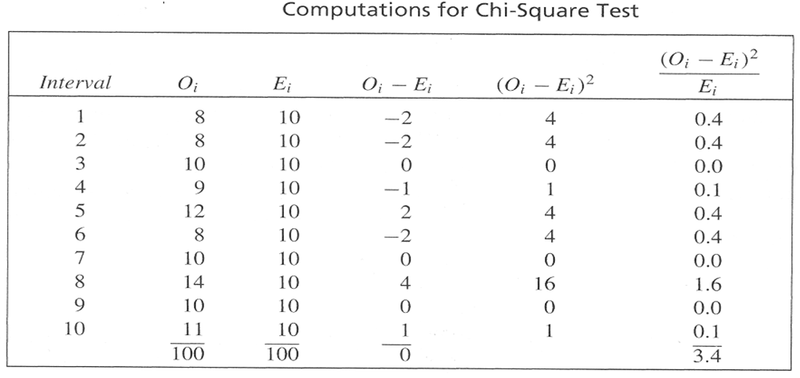
Chi-Square Test(cont.)
The value of χ₀²=3.4; The critical value from table A.6 is χ_{0.05,9}²=16.9. Therefore the null hypothesis is not rejected
34
Notes:
34

Slide 35
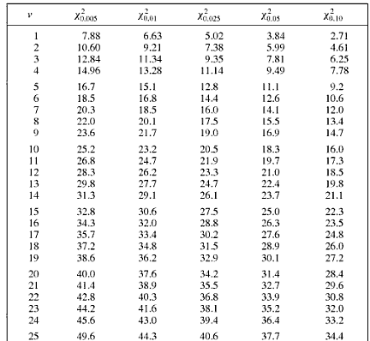
Table A.6 Percentage points of the Chi-Square Distribution with υ degrees of Freedom

Slide 36
Notes on Uniformity tests
Both the Kolmogorov-Smirnov test and the chi-square test are acceptable for testing the uniformity of sample data provided that the sample size is large.
The KS test can be applied to small sample sizes, whereas the chi-square test is valid only for large samples, e.g.: N ≥ 50.
The KS test is more powerful and is recommended

Slide 37
Tests for independence
Sometimes the generators pass the Kolmogorov-Smirnov and chi-square tests but the numbers generated are not independent → need independence tests
Runs Tests :
The runs test examines the arrangement of numbers in a sequence to test the hypothesis of independence.
Run : A run is defined as succession of similar events preceded and followed by a different event.
The length of the Run is the number of events that occur in a Run.
  Example: coin flipping: H T T H H T T T H T
    Six runs: length 1, 2, 2, 3, 1, 1

Slide 38
Runs up and Runs Down
Two concerns in a Runs Test:
The number of Runs
2. The length of the Runs.
An up run is a sequence of numbers which is succeeded by a larger number.
A down run is a sequence of numbers each of which is succeeded by a smaller number.
If a sequence of numbers have too few runs, it is unlikely a real random sequence.
E.g. 0.08, 0.18, 0.23, 0.36, 0.42, 0.55, 0.63, 0.72, 0.89, 0.91, the sequence has one run, an up run. It is not likely a random sequence.
If a sequence of numbers have too many runs, it is unlikely a real random sequence.
E.g. 0.08, 0.93, 0.15, 0.96, 0.26, 0.84, 0.28, 0.79, 0.36, 0.57. It has nine runs, five up and four down. It is not likely a random sequence

Slide 39
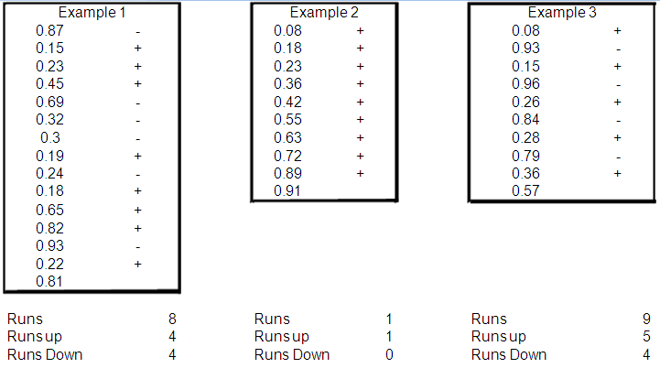
Runs up and Runs Down(cont.)

Slide 40
Runs up and Runs Down(cont.)
  If N is the number of numbers in a sequence, the maximum number of runs is N-1, and the minimum number of runs is one.
  If “a” is the total number of runs in a sequence, the mean and variance of “a” is given by

Slide 41
Runs up and Runs Down(cont.)
  μ_{a} = (2N - 1) / 3
  = (16N - 29) / 90
  For N > 20, the distribution of “a” approximated by a normal distribution, N(μ_{a} , ).
  This approximation can be used to test the independence of numbers from a generator.
  Z₀ = (a - μ_{a}) / σ_{a}
Notes:
30

Slide 42
Runs up and Runs Down(cont.)
  Substituting for μ_{a} and σ_{a} ==>
  Z_{a} = {a - [(2N-1)/3]} / {√(16N-29)/90},
  where Z ~ N(0,1)
  Acceptance region for hypothesis of independence -Z_{α/2} ≤ Z₀ ≤ Z_{α/2}
(ie) if |z| <1.96 then H₀ accepted at 5% level of significance.
if |z| <2.58 then H₀ accepted at 1% level of significance.
Notes:
30

Slide 43
Runs up and Runs Down(cont.)
Example:
Based on runs up and runs down, determine whether the following sequence of 40 numbers is such that the hypothesis of independence can be rejected where α = 0.05.
0.41 0.68 0.89 0.94 0.74 0.91 0.55 0.62 0.36 0.27
0.19 0.72 0.75 0.08 0.54 0.02 0.01 0.36 0.16 0.28
0.18 0.01 0.95 0.69 0.18 0.47 0.23 0.32 0.82 0.53
0.31 0.42 0.73 0.04 0.83 0.45 0.13 0.57 0.63 0.29
Notes:
30

Slide 44
Runs up and Runs Down(cont.)
The sequence of runs up and down is as follows:
+ + + − + − + − − − + + − + − − + − + − − + − − + − + + − − + + − + − − + + −
There are 26 runs in this sequence. With N=40 and a=26,
μ_{a} = {2(40) - 1} / 3 = 26.33 and
= {16(40) - 29} / 90 = 6.79
Then,
Z₀ = (26 - 26.33) / √(6.79) = −0.13
  Now, the critical value is Z_{0.025} = 1.96, so the independence of the numbers cannot be rejected on the basis of this test.
Notes:
30

Slide 45
Runs above and below the mean
The "runs above and below the mean" test is similar to runs up and down, except the runs are based on the difference of the random numbers from the mean.
A positive run is a sequence of numbers above the mean, while a negative run is the opposite.
Again we use the number of random numbers and the number of total runs to calculate the mean and standard deviation.
If there are too many random numbers in a row over or under the mean, we know the numbers are probably not too random and we can reject the hypothesis of independence.

Slide 46



Runs above and below the mean(cont.)
Variables:
N = number of random numbers
n1 = number of runs above the mean
n2 = number of runs below the mean
b = total number of runs
Formula:
Mean =
Variance =
For either n₁or n₂ greater than 20, b is approximately normally distributed

Slide 47
Runs above and below the mean(cont.)
Example: Determine whether there is an excessive number of runs above or below the mean for the sequence of numbers given below:
0.41 0.68 0.89 0.94 0.74 0.91 0.55 0.62 0.36 0.27
0.19 0.72 0.75 0.08 0.54 0.02 0.01 0.36 0.16 0.28
0.18 0.01 0.95 0.69 0.18 0.47 0.23 0.32 0.82 0.53
0.31 0.42 0.73 0.04 0.83 0.45 0.13 0.57 0.63 0.29
The value is lower than the mean -.
The value is higher than the mean +.
- + + + + + + + - - - + + - + - - - - - - + + + + + + + - - - + + - + - - - - - - + + - - - - + + - - + - + - - + + - - - + + - - - - + + - - + - + - - + + -

Slide 48
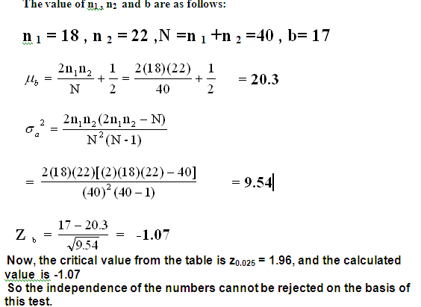
Runs above and below the mean (cont.)

Slide 49
Test for Auto-correlation
The tests for auto-correlation are concerned with the dependence between numbers in a sequence.
Example:
  Examination of the 5th, 10th, 15th, …,etc. indicates a large number in that position.
0.12 | 0.01 | 0.23 | 0.28 | 0.89 | 0.31 | 0.64 | 0.28 | 0.83 | 0.93
0.99 | 0.15 | 0.33 | 0.35 | 0.91 | 0.41 | 0.60 | 0.27 | 0.75 | 0.88
0.68 | 0.49 | 0.05 | 0.43 | 0.95 | 0.58 | 0.19 | 0.36 | 0.69 | 0.87

Slide 50
Random variate Generation

Slide 51
Introduction
Random number : an independent sample drawn from 0 and 1.
Random Variate : an independent sample drawn from a given distribution.
Random Variable : an assignment rule of real numbers to experimental outcome.
Random number generation: Generation of random variates from uniform distribution within the interval [0, 1].
Random variate generation: Generation of random values from a desired probability distribution.
A value randomly generated from a specified probability distribution is called a random variate
(ie) Generation of random variables with other distribution than the uniform one
A random number is actually a random variate from a uniform (0,1) distribution.
The phrase “generating a random variate” refers to the process of obtaining an observation of a random variable from a desired distribution.
For example, a Random variate generator that satisfies the Poisson probability distribution generates random variates that satisfy the Poisson probability distribution.

Slide 52
Random-Variate Generation
Here, we assume that the distributions (type and parameters) are already specified
The basic ingredient needed for every method of generating random variates from any distribution is a source of U(0,1) random variates.
(ie) Given a series of uniform random numbers
How do we generate a sequence of random numbers from a specified probability distribution - Exponential,weibull etc
Generate Uniform
random numbers
Apply transform
to obtain desired
distribution
Random numbers with
desired arbitrary distribution

Slide 53
Random Variate Generation (cont.)
All these techniques assume that a source of uniform (0, 1) random numbers is available; R₁, R₂,..., where each R_{i} has:
⎧1 , 0 ≤ x ≤ 1
pdf: f_{R}(x) = ⎨
⎩0 , otherwise
and
⎧0 , x < 0
cdf: F_{R}(x) = ⎨x , 0 ≤ x ≤ 1
⎩1 , x > 1
Note: The random variable may be either discrete or continuous.
Notes:
30

Slide 54
Inverse Transform Technique
The inverse transform technique can be used to sample from the exponential, the Weibull and the uniform distributions, and empirical distribution.
Additionally, it is the underlying principle for sampling from a wide variety of discrete distributions.
A step by step procedure for the inverse transform techniques, illustrated by the exponential distribution, is as follows:
Inverse transform method:
Step 1 – compute cdf of the desired random variable X
Step 2 – Set F(X) = R where R is a random number ~U[0,1)
Step 3 – Solve F(X) = R for X in terms of R. X = F⁻¹(R).
Step 4 – Generate random numbers R_{i} and compute desired random variates:
X_{i} = F⁻¹(R_{i})

Slide 55
Inverse transform method – Exponential Distribution
  The pdf of exponential distribution is
⎧ λe^{-λx} , 0 ≤ x f(x) = ⎨
⎩ 0 , x < 0
The cdf is
F(x) = f(t) dt
⎧ 1 - e^{-λx} , 0 ≤ x
= ⎨
⎩ 0 , x < 0

Slide 56
Inverse transform method – Exponential Distribution:
Step 1 – compute cdf of the desired random variable X
Step 2 – Set F(X) = R where R is a random number ~U[0,1)
Step 3 – Solve F(X) = R for X in terms of R.
Step 4 – Generate the exponential random numbers (X_{i}), using the uniformly generated random numbers R_{i}
Note: It is justified that both 1 - R_{i} and R_{i} are uniformly distributed on (0, 1).

Slide 57
Example: Generation of Exponential Variates X, with Mean 1, Given Random Numbers Ri,
The above Table gives a sequence of random numbers and the computed exponential variates, Xi, given by Equation
with a value of λ = 1.
i 1 2 3 4 5
Ri 0.1306 0.0422 0.6597 0.7965 0.7696 Xi 0.1400 0.0431 1.078 1.592 1.468

Slide 58
Uniform Distribution
Consider a random variable X that is uniformly distributed on the interval [a, b]. all we know about X is that it takes a value between a and b
The pdf of X is given by
  Step 1 The cdf is given by
  Step 2 Set F(X) = (X – a) / (b – a) = R
  Step 3 Solving for X in terms of R yields X = a + (b – a) R
  Step 4: Xi = a + (b – a) Ri
0
a
b

Slide 59
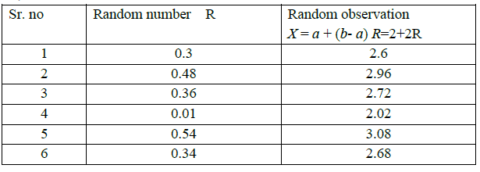
Uniform distribution
Example Given a=2 and b= 4 generate six random observations using random numbers, 0.3, 0.48, 0.36, 0.01, 0.54, 0.34

